Slide 1
Meaning of project
A project in business and science is a collaborative enterprise, frequently involving research or design, that is carefully planned to achieve a particular aim.
Project management has long provided a structured, organized and mathematical way to achieve success every time that include :
Introducing new processes
Finding new and better procedures and working practices
Throwing off the old habits to create a more dynamic and flexible organization
Being able to react effectively to market forces
Searching for ways to maintain competitiveness
Searching for ways to seek new horizons

Slide 2
Importance of Projects (Characteristics) :
A Project…
has a specific purpose that can be readily defined, focused more on customer demands .
is not usually routine work but may include routine-type tasks and also most unlikely to be repeated in exactly the same way by the same group of people to give the same results in next cycle.
is made up of a collection of activities having clearly defined and agreed time constraints that are linked together to contribute collectively to the desired result
involves risks at every step that must be managed to sustain the focus on the desired results.
involves many unknowns like skill levels of workers , external influential factors, cost constraints, which have to be clarified, defined and understood to ensure stability till successful completion of the project .
provides a unique opportunity to learn new skill in parallel to face new challenges and threats that are most common, can be handled by unique role of coordinating other than just managing alone.

Slide 3
Project Identification…. Hints
To think of establishing a 5S1 Unit by common man or an individual can be named as an OPPORTUNITY, which is IDENTIFICATION of a project idea having a good returns or monitory yield for the investment of hard work, skill & small amount of money.
Generally, people who start their own businesses can be grouped broadly into 2 types.
Type 1- i) Who knows what exactly they want to do
ii) Having good experience
iii) Already developed many skills necessary to succeed
iv) Looking for opportunity to explore their knowledge
v) Likely to be familiar with industry customs & practice
required for new business start-up
Type II - i) Who don’t have definite ideas about what they want to do
ii) Don’t have experience of business in their career
iii) Have developed skills in education or required for job
iv) Field of interest is totally different from their experience
Hence the Type-I people have more chances in succeeding business compared to other Type-II

Slide 4
Selection of a Project
Selection of the project is one of the “FORMALITIES FOR SETIING UP OF A SMALL BUSINESS ENTERPRISE”.
Hence a strong experienced entrepreneur plays key role in identification & setting up of the project successfully to realize the benefits.
Because of ‘Project Selection’ being a first step, that needs more attention and carefully choice for further consequences.
In general following are the STEPS of formalities in setting up of a small business:
selecting a product or service
Identification of location for the unit
A project feasibility study to be conducted for all pros & cons.
Preparation of a brief profile for the proposed project.
Preparation of business plan
Depending on above facts the finance or investment has to be finalized for the project.
At last entrepreneur proceeds to further steps in establishing the unit
Graphical representation of the same as follows,

Slide 5
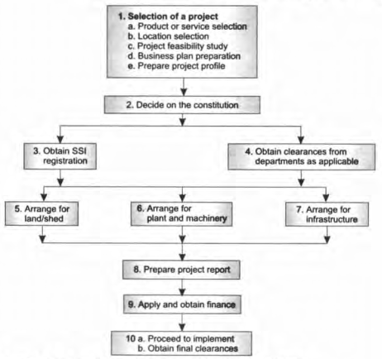
Steps of setting up Small Scale Industry

Slide 6
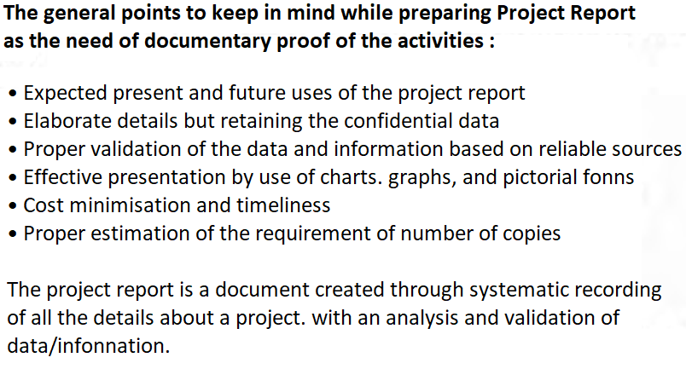
Preparation of Project Report:

Slide 7
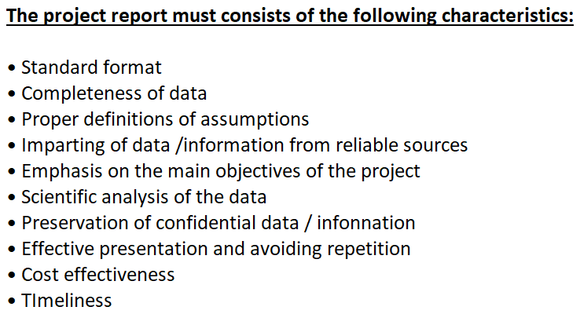

Slide 8
Significance of the PROJECT REPORT: Essential points to remember:
Idea about the new task
Statutory regulations and restrictions
Technical details about production
Process Chart
Requirement of manufacturing facilities like land, building. plant and machinery. auxiliary services etc.
Marketing of finished products
Organization chart
Manpower requirement
Availability of raw materials, consumables, power, and other services
Quotations for creation of assets
Technical collaborations/agreements
Other financial details
Promoter's bio-data
Details of the existing unit in parallel with similar one having same product & service.
Knowledge about debt market

Slide 9
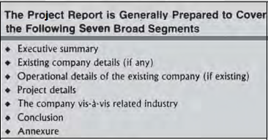

Slide 10
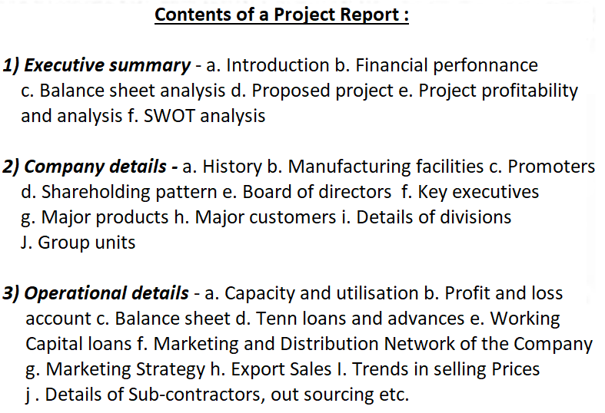

Slide 11
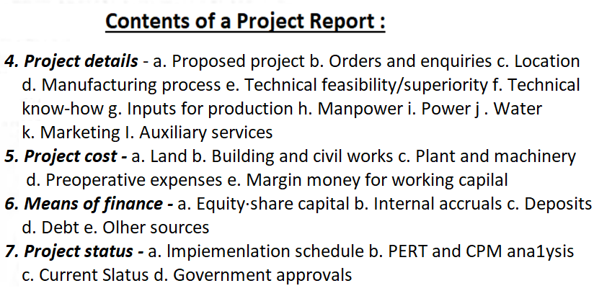

Slide 12
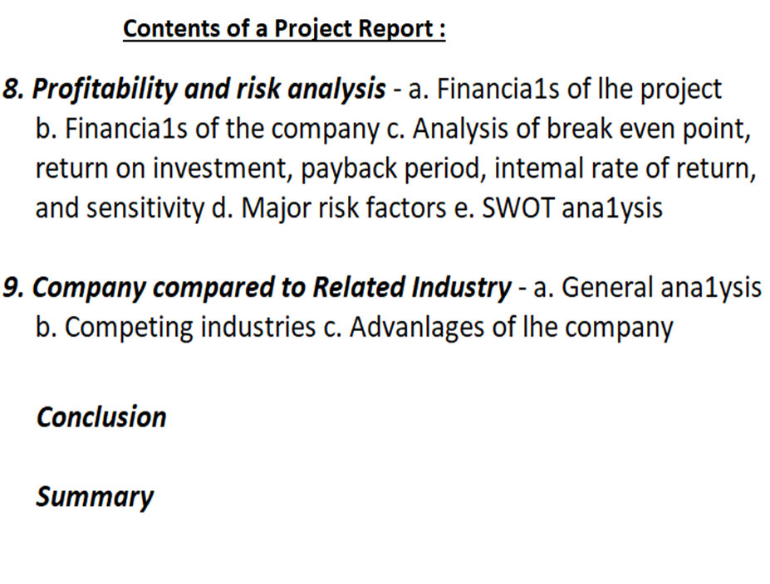

Slide 13
Planning Commission of India
Guidelines for
Formulating Project Report
General Information
Preliminary Analysis of Alternatives
Project Description
Marketing Plan
Capital Requirements and Costs
Operating Requirements and Costs
Financial Analysis
Economic Analysis
Miscellaneous Aspects

Slide 14
Explanation of each:
General Information: Name and Location of Project
Preliminary Analysis of Alternatives: Name of Administrative Department. Secretary, phone, fax, Email
Project Description: Method of execution of the project- State Govt. PWD/ Central Govt. / NGO/public sector undertaking,/Pvt. Companies
Marketing Plan: List of consultants proposed to be contacted for preparation of Detailed Project Report.
Capital Requirements and Costs: Description of Projects like objectives, background, components, project rationale, manpower required, expected impact on the sector including state’s economy
Operating Requirements and Costs: Schedule of clearances required for the processing of the investment proposal: Plan of action and timetable for various steps.
Financial Analysis: Linkages with ongoing projects and finances associated.
Economic Analysis: Planning commission’s project preparation facility (PCPPF) helping state Govt. to check the preparation of Detailed Project Reports for projects funded from external and institutional sources.
Miscellaneous Aspects: Gist of informal discussions on acceptability and funding of project held with external agencies, financiers, Government of India, Ministries.

Slide 15
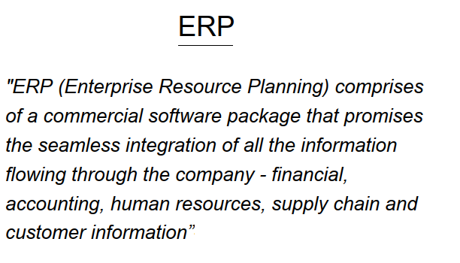

Slide 16
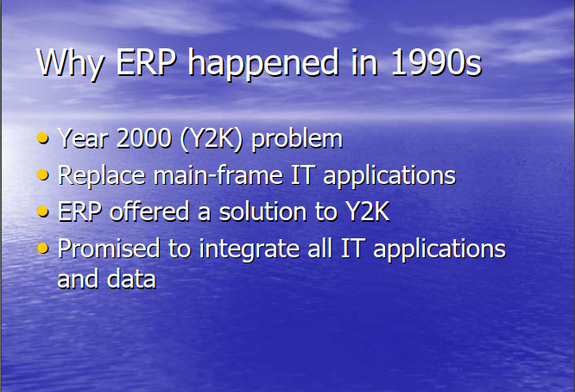

Slide 17
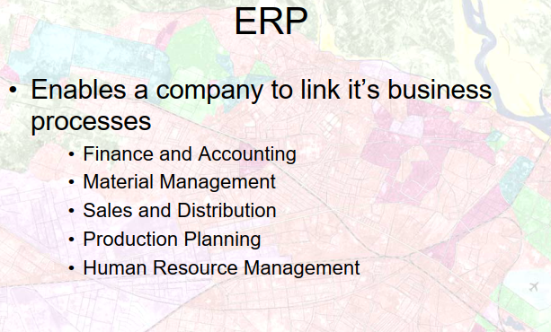

Slide 18
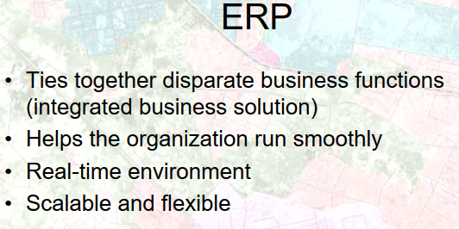

Slide 19
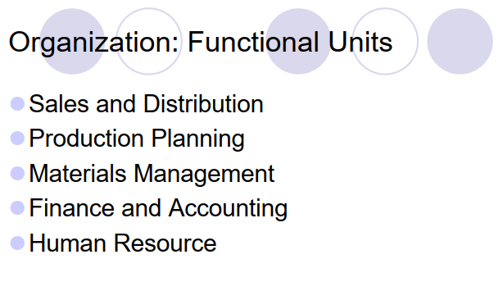

Slide 20
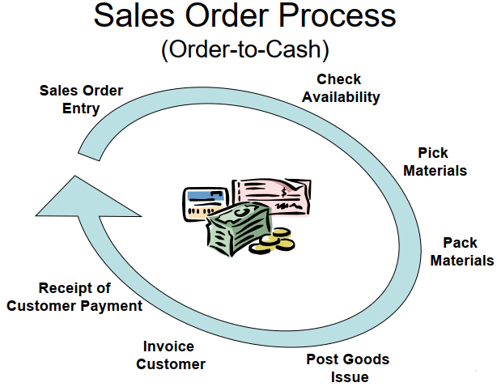

Slide 21
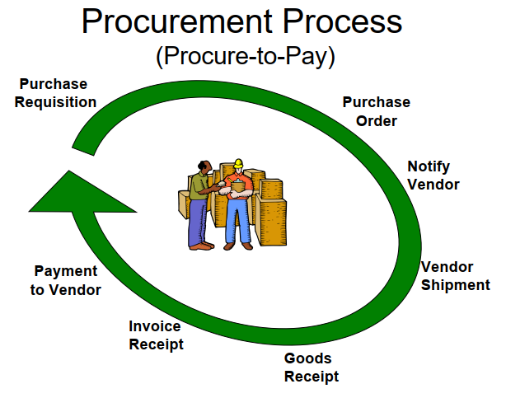

Slide 22
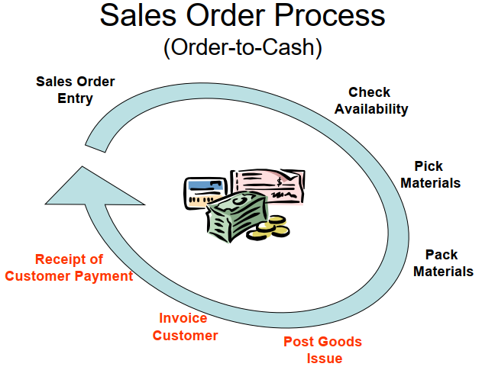

Slide 23
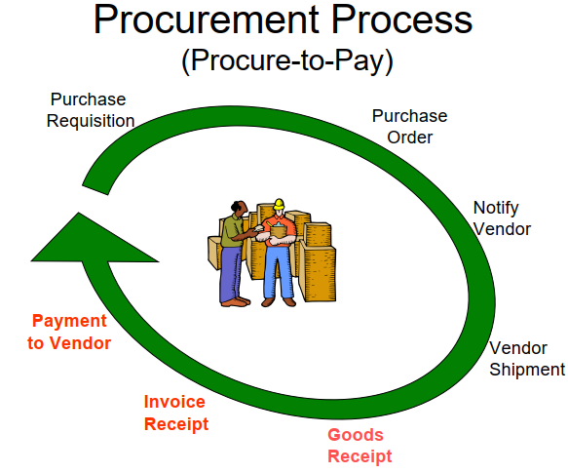

Slide 24
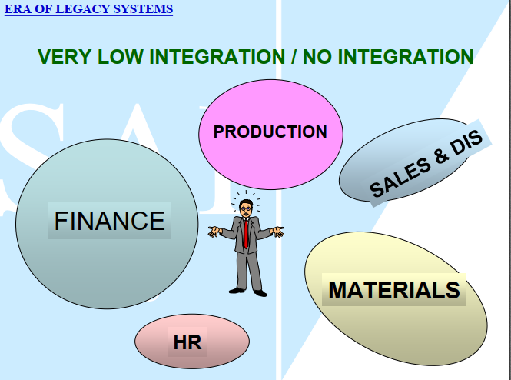

Slide 25
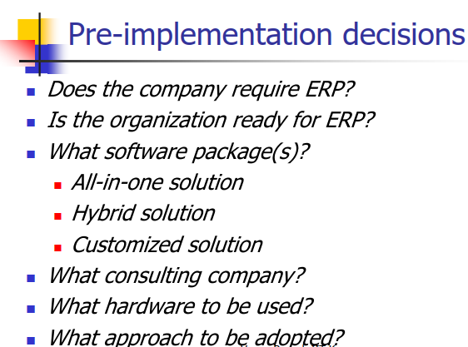

Slide 26
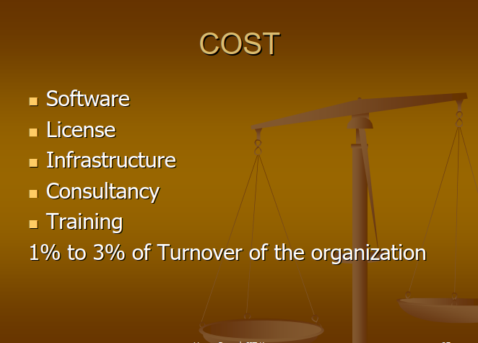

Slide 27
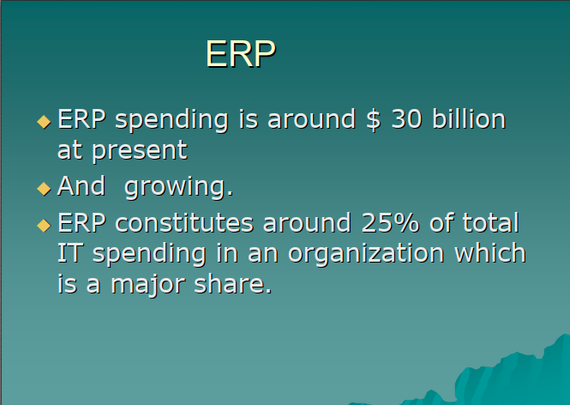

Slide 28
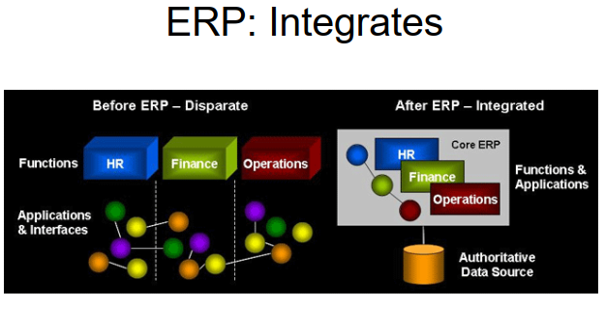

Slide 29
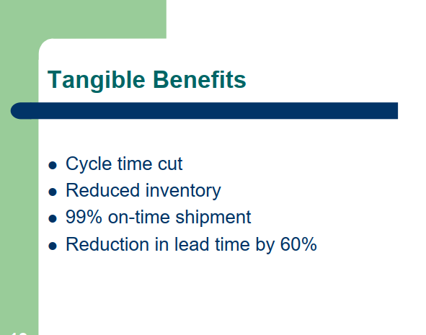

Slide 30
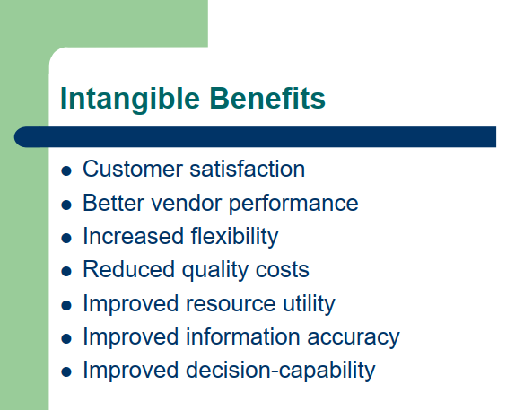

Slide 31
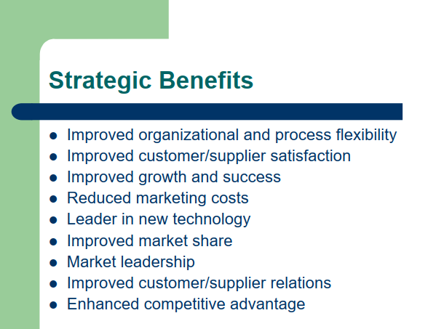

Slide 32
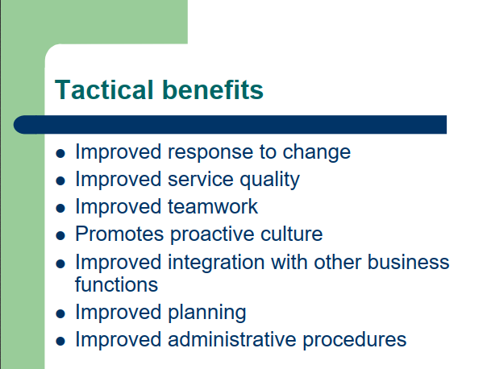

Slide 33
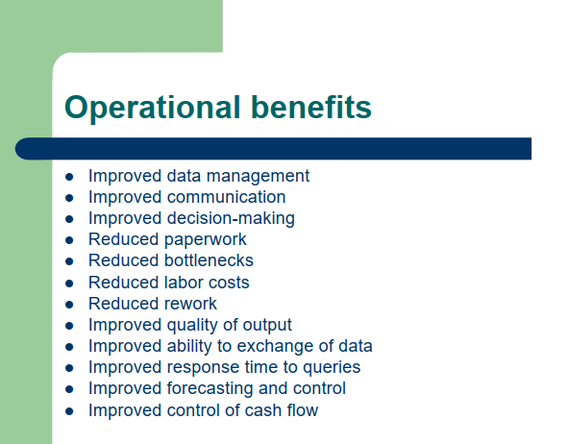

Slide 34
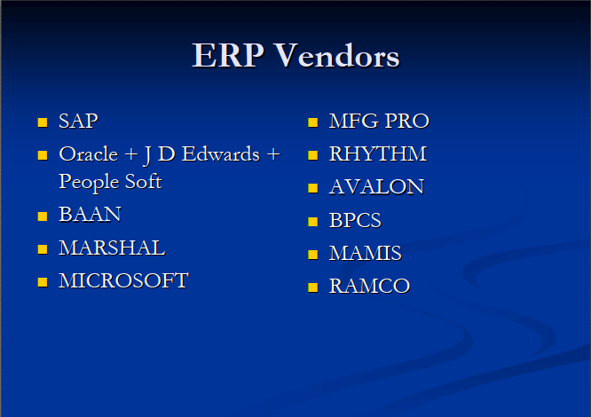

Slide 35


